Slide 1
onCareer
March 13, 2018
Team onCareer
Project Owner: Steven Suh
Members: Drew Caltagirone, Kyle Batross, Swapnil Patil, Tony Dang, Jeff Yang

Slide 2
Intro to Problem and Application Domain
As job search becomes more accessible to everyone, there needs to be an effective way to manage job applications.
Therefore, we intend to create a web application that helps users organize and keep track of job applications in an efficient manner.

Slide 3
Goals
Set out to achieve:
Have a working and usable website
Ability to track and organize Job Applications
Be able to create new boards and organize applications / other information
Be able to login and save your boards in a database
Be able to prototype test and have little to no bugs
Be able to continuously integrate new features
Have a good aesthetically pleasing and user friendly UI
Implement a Google calendar to keep track of past and future appointments
Be able to analyze the jobs that have been applied to
Goals achieved:
We achieved (basically) all of our goals that we set out to achieve!

Slide 4
Biggest Challenges and Accomplishments
Challenges:
Working with new technologies
Different teammates have different levels of programming skills
Differing schedules
Accomplishments:
Created a web application relevant to all of us
Used new technologies and methodologies
Learned a lot of frontend and backend web technology
Able to implement different APIs

Slide 5
Systems Overview
https://drive.google.com/file/d/1pFiBeZSNbMhPCwef9R88q2JurUQJCwfH/view?usp=sharing
Prototype Idea:
https://www.figma.com/file/fzAR0uvRmJXK7BZ9L2YOoEsE/CS115-Job-App-Organizer

Slide 6



Technologies
Programming Languages: JavaScript, HTML, CSS
Web Technologies: Node.js, React, MongoDB, Google Calendar API
Tools and Environments: Git, GitHub, Slack, Google Drive

Slide 7
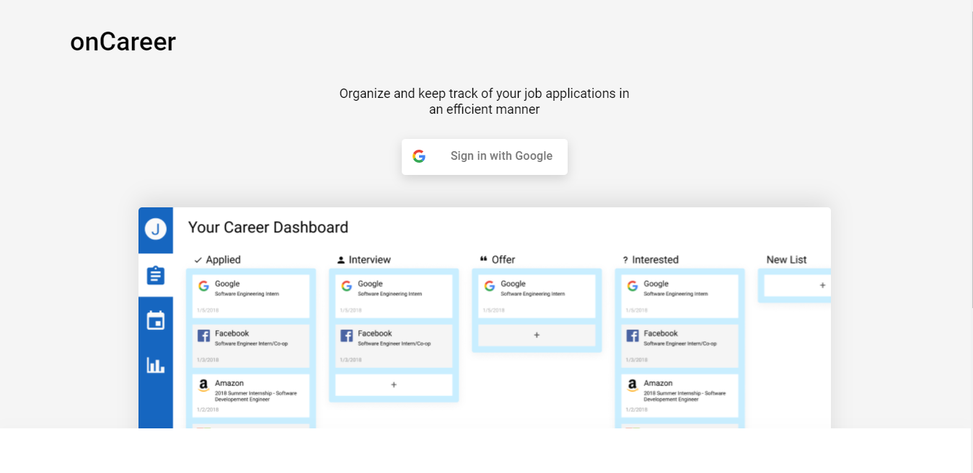
Screenshots (Landing Page)

Slide 8
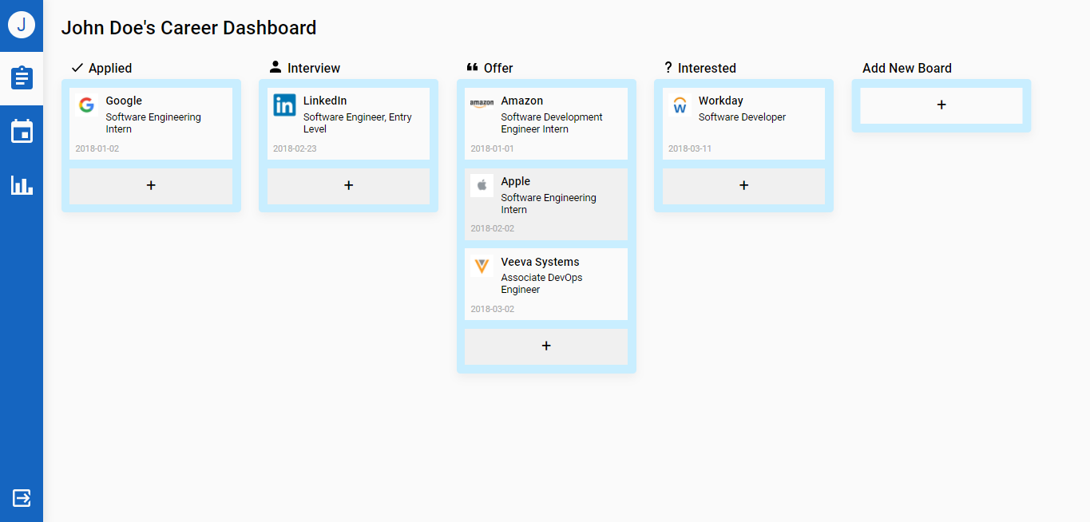
Screenshots (Dashboard)

Slide 9
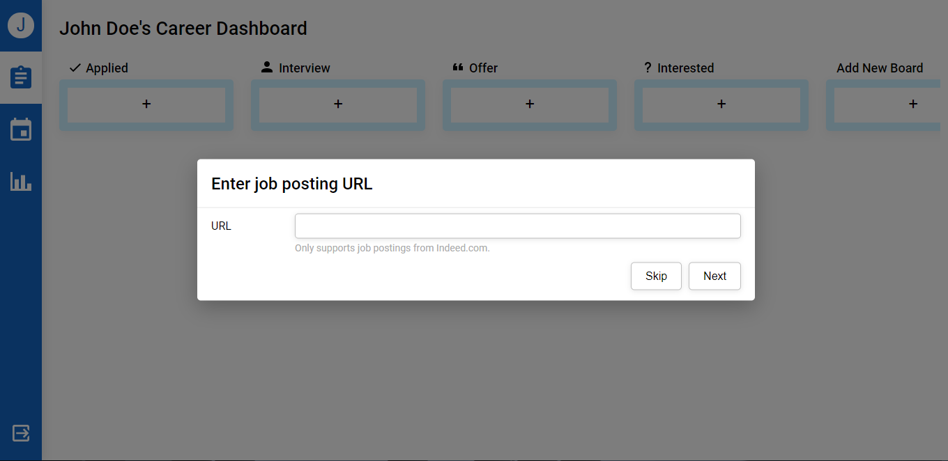
Screenshots (Adding Job Application via URL)

Slide 10
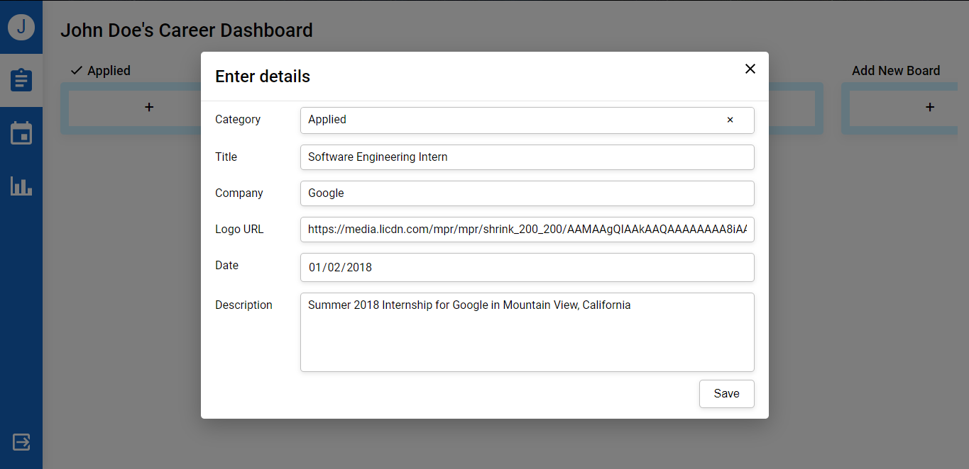
Screenshots (Adding Job Application)

Slide 11
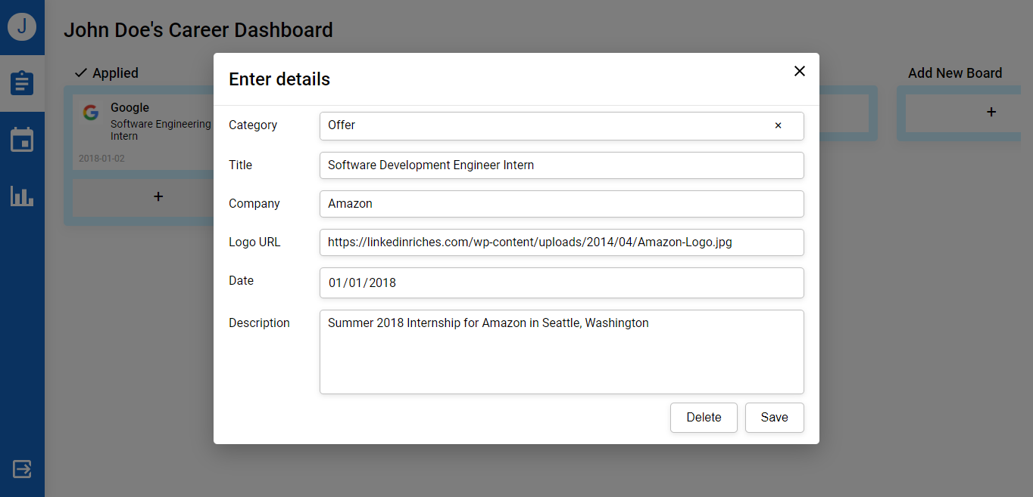
Screenshots (Editing Job Application)

Slide 12
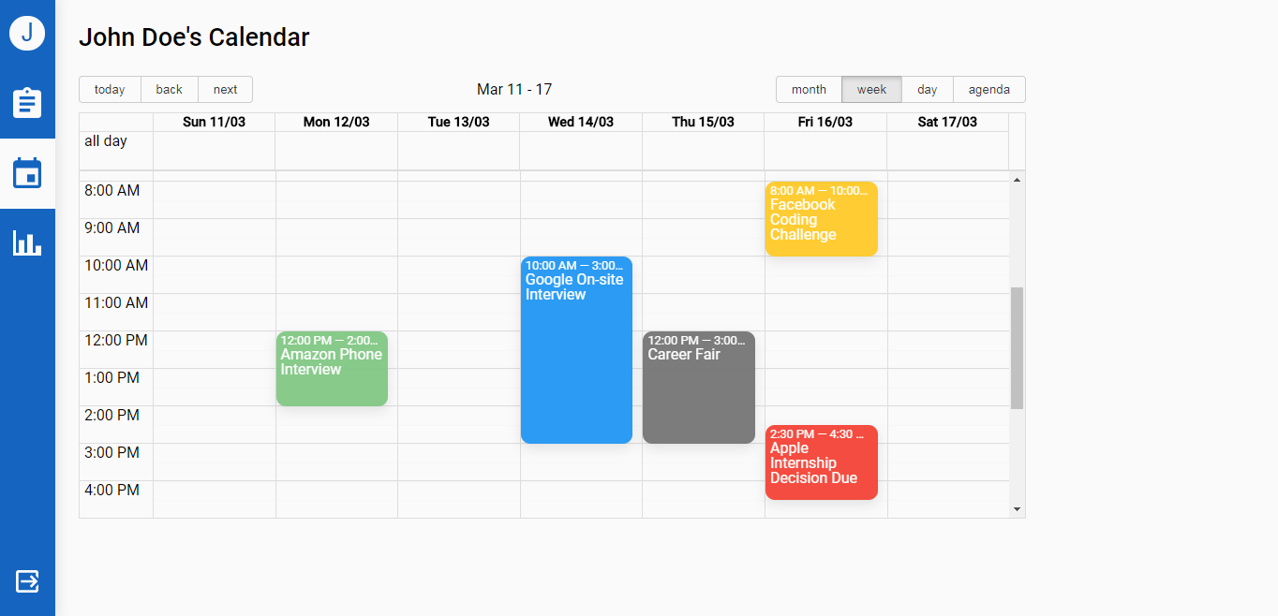
Screenshots (Calendar)

Slide 13
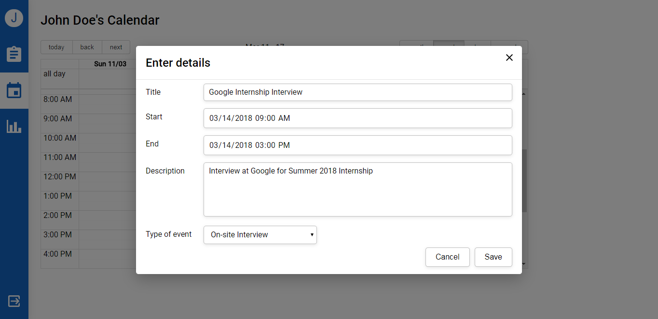
Screenshots (Adding Calendar Event)

Slide 14
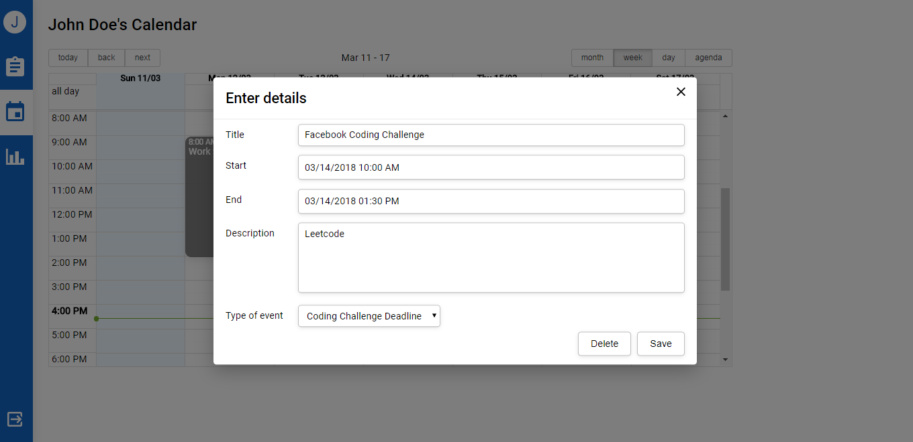
Screenshots (Editing Calendar Event)

Slide 15
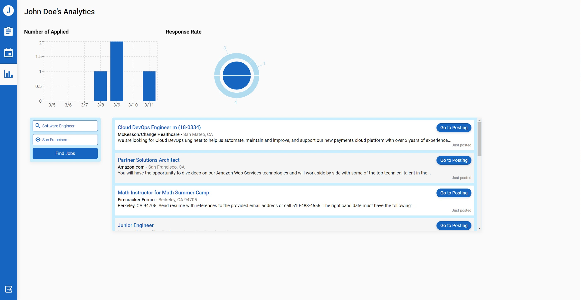
Screenshots (Analytics)

Slide 16
Things you Enjoyed and Not Enjoyed
Enjoyed:
Completing work efficiently and on time
Learning new technologies
Creating a web app that is user-friendly
Working with a group of great members and developers
Did Not Enjoy:
Planning meeting times around everyone schedule
Version Control issues occasionally
Having to worry about other classes at the same time as the project

Slide 17
Lessons Learned
What worked:
Communicating via slack
Merge/ pull requests on Github
Allocating tasks to 1-3 people at a time
What didn’t work:
Having all members present 100% during stand up meetings
Things we wish we done:
More days to code together
Google hangout meetings with normal SCRUM meetings

